Slide 1
E-Xtend Appendices
Group 7
Reiniel Joshua Garcia Sahiti Sri Upputuri Sarthak Jain, Tarun Chittadi Yatharth Jain

Slide 2
Appendix A - E-Waste
https://www.reportlinker.com/insight/give-kid-tablet-ask-time.html
https://www.ewaste.com.au/ewaste-articles/electronic-waste-by-numbers-recycling-the-world/
https://www.theworldcounts.com/stories/electronic-waste-facts

Slide 3
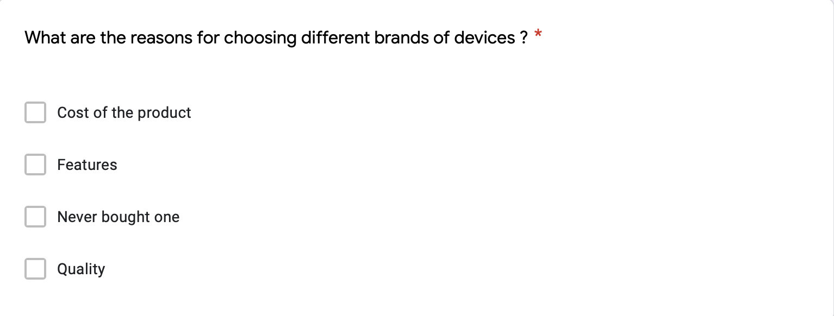

Appendix B - Customer Market Research Survey

Slide 4
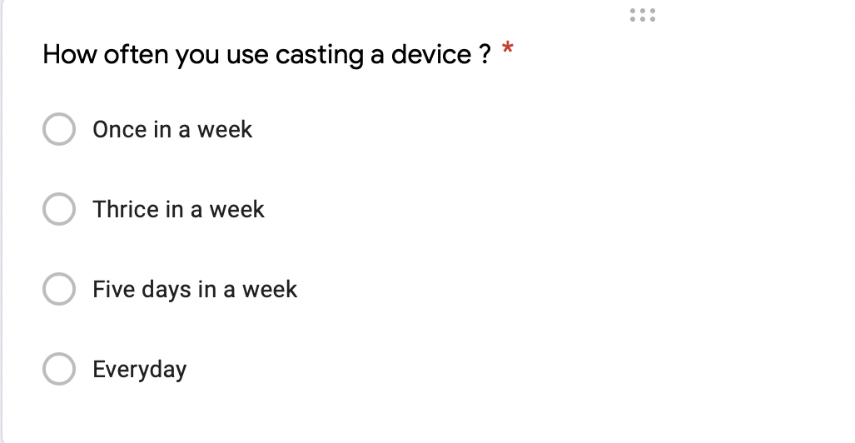


Slide 5



Slide 6
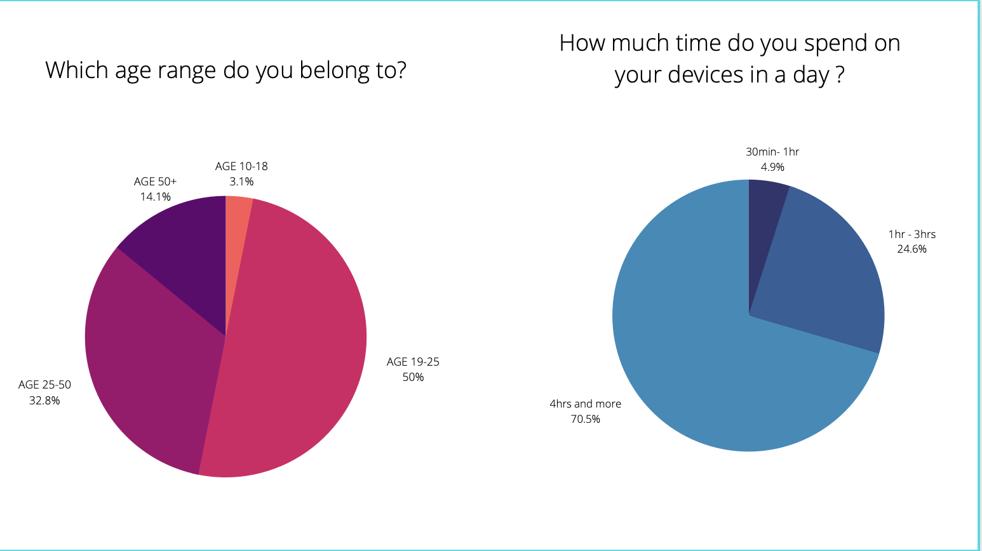

Slide 7
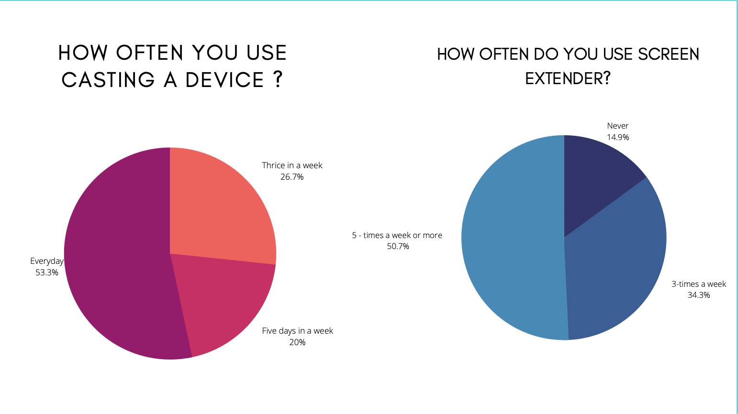

Slide 8
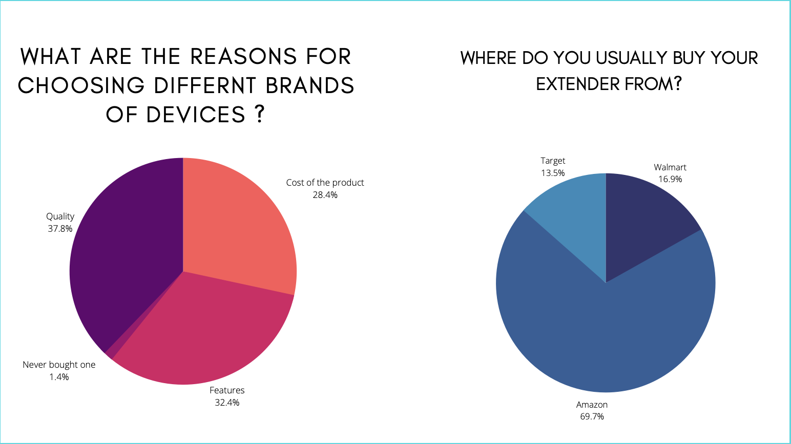

Slide 9
Appendix C - Competitive Analysis
Competitors | Service Advantages | Service Disadvantages | Pricing
Mira Screen | Provide Screen casting extended to at least 1 to 4 devices. Also, flexible with cross-platform like IOS/ Android | Not flexible Doesn’t provide security A bit expensive also with limited features | $45
EZ Cast Pro | Flexible to connect with any device. Comes with a HDMI extender Secured and any cross platform works | Product is highly expensive Doesn't provide high quality streaming | $137

Slide 10
Appendix D - Population (Texas)

Slide 11
Appendix E - Population (OK, NM, LO)
Yr2 | Population | Working Population (US-60%) | IT Equipment User (US- 78%)
Lousiana | 4,649,000 | 2,789,400 | 2,175,732
Ok | 3,957,000 | 2,374,200 | 1,851,876
New Mex | 2,097,000 | 1,258,200 | 981,396
 |  |  | 5,009,004

Slide 12
Appendix F - Population (East Coast)
Yr3 | Population | Working Population (US-60%) | IT Equipment User (US- 78%)
NY | 8,419,000 | 5,051,400 | 3,940,092
NJ | 8,882,000 | 5,329,200 | 4,156,776
RI | 1,059,000 | 635,400 | 495,612
DL | 9,737,640 | 5,842,584 | 4,557,216
CT | 3,565,000 | 2,139,000 | 1,668,420
WAS DC | 692,683 | 415,610 | 324,176
MAS | 6,893,000 | 4,135,800 | 3,225,924
Total | 39,248,323 | 23,548,994 | 18,368,215

Slide 13
Appendix G - Sales Plan
For More Details: Look at the Provided Excel Sheet

Slide 14
Appendix H - Timeline of Events
30 Days: Incorporation and Set up
6 Months: Build the software, Website and supporting infrastructure
15 Days: Hire Software Developers (Simultaneously as incorporation)
3 Months (After 2 months of Software Development)
5 Months: Set up Manufacturing – Beta Testing in Austin Market and Refinement
12 Months: Launch in Dallas Market
2 Months: Launch in Rest of Texas
End of Year 1: Rollout in Louisiana, Oklahoma, and New Mexico
End of Year 2: Rollout in East Cost

Slide 15
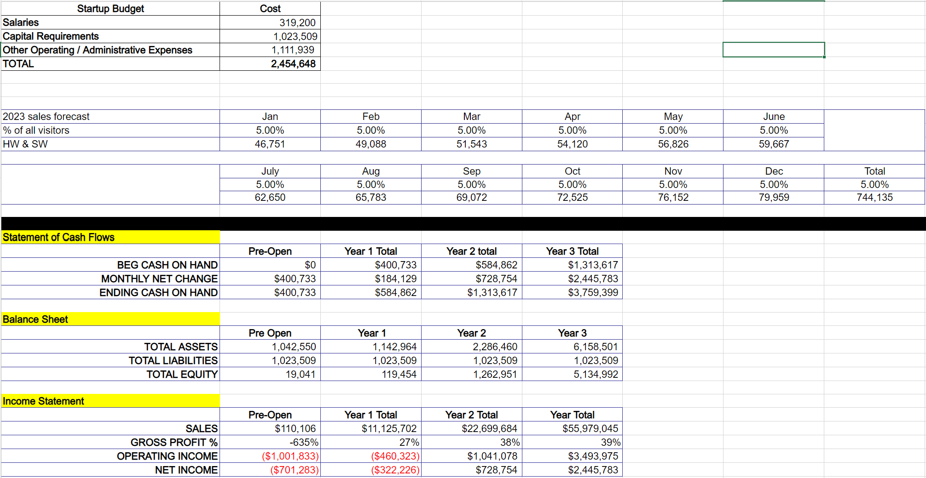
Appendix I - Summary of Finances
For More Details: Look at the Provided Excel Sheet

Slide 16
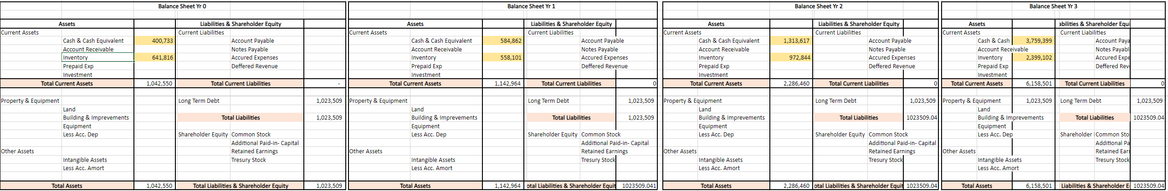
Appendix J - Balance Sheet
For More Details: Look at the Provided Excel Sheet

Slide 17
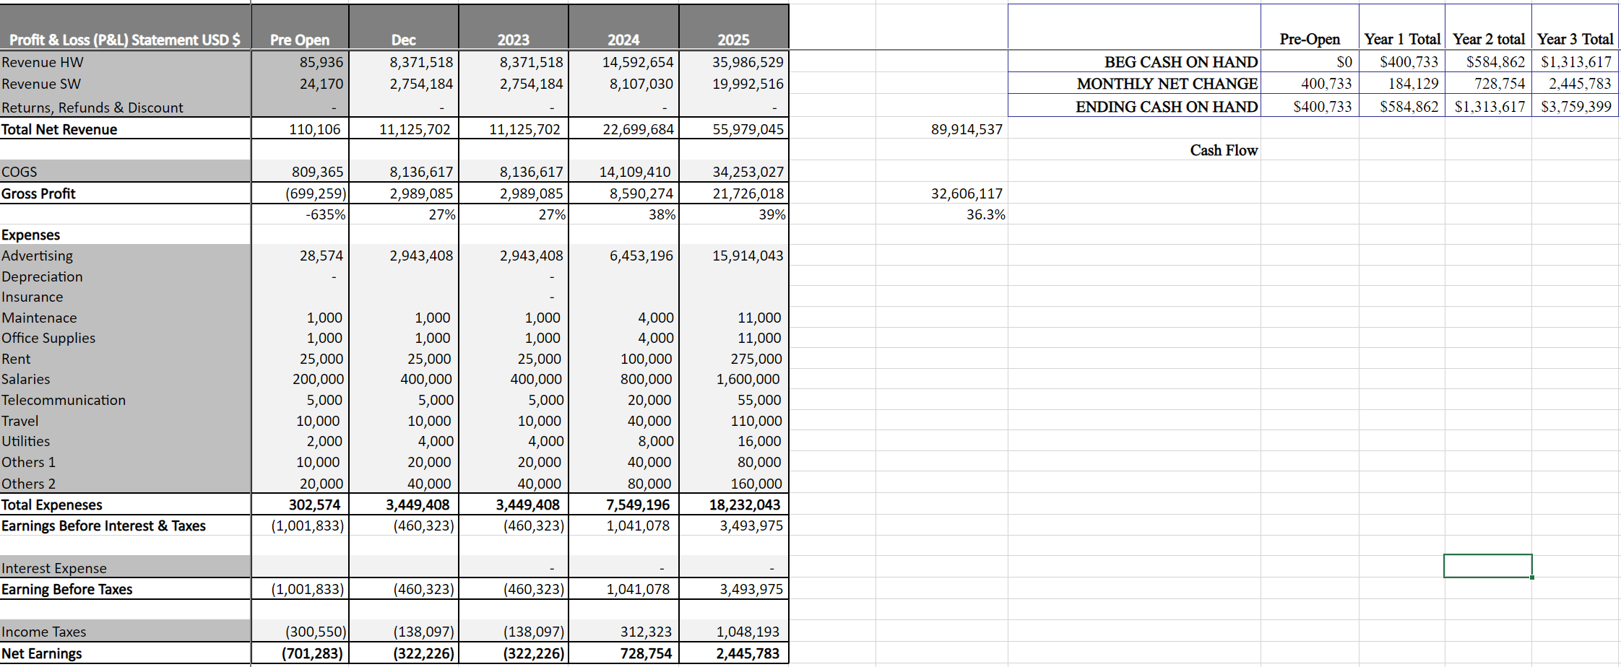
Appendix K - Profit/Loss Statement
For More Details: Look at the Provided Excel Sheet

